Slide 1

TECHNICAL PRESENTATION
Presented by : Dhaanush Rajan - 192421162
Subject code: CSA5116
Subject: CRYPTOGRAPHY AND NETWORK SECURITY
Guide name : Dr. E. ANBALAGAN

Slide 2


INTRODUCTION
Cryptography is the science of protecting information by converting plaintext into ciphertext so that unauthorized users cannot read it.
Basic Terms
Plaintext (P): Original readable message.
Ciphertext (C): Encrypted unreadable message.
Encryption: Process of converting plaintext into ciphertext.
Decryption: Process of converting ciphertext back into plaintext.
Key: Secret value used for encryption and decryption.
Cipher: Algorithm used for encryption and decryption.

Slide 3
Security Attacks, Threats, and Risks
Security Attack
A security attack is an attempt to compromise the confidentiality, integrity, or availability of information.
It aims to gain unauthorized access, modify, destroy, or disrupt data.
Types of Security Attacks
A. Passive Attack
The attacker only monitors or intercepts the communication.
No changes are made to the data.
Difficult to detect because the system remains unchanged.
Mainly affects confidentiality.
Examples:
Eavesdropping (Listening to private communication)
Traffic Analysis (Analyzing communication patterns)

Slide 4
B. Active Attack
The attacker modifies, inserts, deletes, or destroys data.
Easier to detect than passive attacks.
Affects integrity, availability, and authentication.
Examples:
Masquerade Attack – Pretending to be an authorized user.
Replay Attack – Reusing captured data or messages.
Message Modification – Altering the original message.
Denial of Service (DoS) Attack – Making a service unavailable to users.

Slide 5
Threat
A threat is any potential event or action that can harm a system or its data.
It exploits vulnerabilities in a system.
Threats may be intentional or accidental.
Examples:
Malware (Viruses, Worms, Trojans, Ransomware)
Hackers (Unauthorized users)
Natural Disasters (Floods, Earthquakes, Fire)
Insider Attacks (Employees or trusted users misusing access)
Risk
Risk is the possibility of loss or damage caused when a threat exploits a vulnerability.
It measures the potential impact on an organization.
Risk can be reduced by implementing appropriate security controls.
Formula:
Risk = Threat × Vulnerability × Impact
Where:
Threat: A potential source of danger.
Vulnerability: A weakness that can be exploited.
Impact: The extent of damage caused if the threat occurs.

Slide 6
Bell-LaPadula Model
Definition
The Bell-LaPadula model is a formal access control framework developed in the 1970s for the U.S. Department of Defense to protect classified data
The Bell-LaPadula (BLP) Model is a security model developed to protect the confidentiality of sensitive information.
It ensures that users can access only the information they are authorized to view.
It is mainly used in military, government, and defense organizations where classified information must be protected.
Objectives
Protect confidential information.
Prevent unauthorized access to sensitive data.
Control information flow between different security levels.
Security Levels
Top Secret (TS) – Highest level of security.
Secret (S) – High level of confidentiality.
Confidential (C) – Moderate level of security.
Unclassified (U) – Lowest level of security.

Slide 7
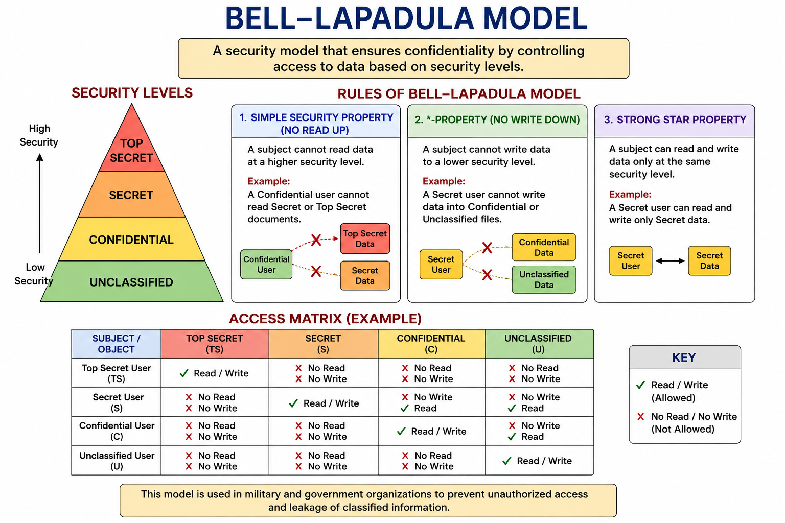

Slide 8
Encryption Schemes
Definition
Classical encryption schemes are traditional methods used to protect data by converting plaintext into ciphertext.
They rely on substitution and transposition techniques.
Types
1. Substitution Cipher
Replaces each letter of the plaintext with another letter or symbol.
The positions of the letters remain unchanged.
Example:
Plaintext : HELLO Ciphertext: KHOOR
2. Transposition Cipher
Rearranges the positions of letters without changing the letters themselves.
Example:
Plaintext : COMPUTER Ciphertext: CPEOURMT

Slide 9
Basis | Substitution Cipher | Transposition Cipher
Definition | Replaces each plaintext character with another character or symbol. | Rearranges the positions of plaintext characters without changing the characters.
Principle | Character replacement | Character rearrangement
What Changes? | Letters change | Positions of letters change
Order of Characters | Remains the same | Changes
Characters Used | Different characters are produced | Same characters are used
Letter Frequency | Frequency of letters is preserved but mapped to different letters | Letter frequency remains exactly the same
Security | Hides the identity of letters | Hides the order of letters
Example | HELLO → KHOOR | COMPUTER → CPEOURMT
Advantages | Simple to implement and understand | Preserves original letters while scrambling the message
Disadvantages | Vulnerable to frequency analysis | Weak if used alone and can be broken by pattern analysis
Use Cases | Caesar Cipher, Monoalphabetic Cipher, Vigenère Cipher, Hill Cipher | Rail Fence Cipher, Columnar Transposition Cipher

Slide 10
Steganography
Definition
Steganography is the ancient and modern practice of concealing secret information within an ordinary, non-secret file or medium so that the very existence of the data remains hidden. Unlike cryptography, which scrambles a message to make it unreadable, steganography hides the message in plain sight to avoid detection entirely.
How it Works
At its core, steganography embeds data within a "carrier" medium (such as an image, audio, or video file) by slightly altering the host file without degrading its quality to the naked eye.
Least Significant Bit (LSB): In digital images, colors are represented by binary numbers. The LSB is the furthest right bit. Altering it only causes an imperceptible change in color. These bits are overwritten to secretly encode hidden files or text.
File Selection: Formats like PNG (which use lossless compression) are typically preferred for image steganography over JPEG, as compression can corrupt the hidden data.

Slide 11
THANK YOU!

